Slide 1

DigiFinance
Shuban Devanpelli(22107023)
Rishi Bije(22107002)
Yash Kamble(22107055)
Dhanraj Bacche(22107056)
Project Guide
Ms.Sarala Marry

Slide 2
Outline
Introduction
Literature Survey of the existing systems
Limitations of the existing systems
Problem statement
System Design
Technologies and methodologies
Implementation
Conclusion
References

Slide 3
Introduction
Digi finance is a web-based application designed to help individuals track, manage, and optimize their finances.
It has tools that can assist in budgeting, tracking expenses, setting financial goals, and monitoring investments.
By using these tools, individuals can gain better control over their financial situation and make more informed decisions.
Motivation:
By observing that people are increasingly looking to manage their own finances, investments, and budgeting we were inspired to create a unified solution for users.

Slide 4
Objective:
To provide users with tools to set, track, and analyze budgets, offering insights and alerts using advanced data visualization techniques to help maintain financial control.
To deliver personalized investment recommendations, utilizing fuzzy logic for stock recommendations.
To empower users with comprehensive tools and insights using recommendation algorithms to achieve financial stability and reduce financial stress.
To utilize linear regression algorithms to predict future expenses, aiding in informed financial planning.

Slide 5
Literature Survey of the existing system
Sr No | Title | Author | Year | Outcome | Methodology | Result
1. | [1]The Future of Personal Finance Management – A Machine Learning-Driven Approach for Predictive Analysis and Efficient Expense Tracking | Uyanahewa M.I.R, Jayawardana G.V.H.D, Bandara M.B.D.N, Hapugala H.A.V.V, Buddhima Attanayaka, Dasuni Nawinna | 2023 | Future enhancements and research directions could further solidify its position as a valuable tool for both individual users and organizations, enhancing its applicability and effectiveness in diverse financial contexts. | The research demonstrates a well-structured approach to integrating machine learning for financial management, improving accuracy in expense tracking, classification, and prediction through a combination of pre-processing techniques, sophisticated models, and rigorous evaluation. | Addressing the shortcomings of existing solutions and leveraging advanced technologies, the application has the potential to greatly improve financial literacy and management practices.

Slide 6
Literature Survey of the existing system
Sr No | Title | Author | Year | Outcome | Methodology | Result
2. | [2] Prediction of Accrual Expenses in Balance Sheet Using Decision Trees and Linear Regression | Chih-Yu Wang, Ming-Yen Lin | 2016 | Adopting these advanced modeling techniques helps bridge gaps in the company’s financial forecasting and planning, leading to better decision-making and resource management. | The research study’s systematic approach ensures that the data is accurately represented and modeled, providing a robust basis for predicting unused annual leave hours and potentially improving personnel management practices within the company. | The decision tree model significantly outperformed the linear regression model, providing a much lower error rate and more accurate predictions of unused annual leave hours.

Slide 7
Literature Survey of the existing system
Sr No | Title | Author | Year | Outcome | Methodology | Result
3. | [3] A Trend-aware Investment Target Recommendation System with Heterogeneous Graph | Miao Chen , Chao Wang, Chuan Qin , Tong Xu , Jianhui Ma , Enhong Chen, Hui Xiong | 2021 | Our approach demonstrated substantial improvements in recommendation accuracy by effectively utilizing sequential patterns and structural information. | The combination of description extraction, trend analysis, and preference propagation ensures that the recommendations are based on comprehensive and contextually relevant information, improving the quality of investment suggestions for users. | The proposed Investment Target Recommendation System (ITRS) effectively integrates sequence modeling, trend extraction, and preference propagation, outperforming various baseline methods

Slide 8
Limitations of existing systems
Lack of Real-Time Personalization: Many financial apps don’t update in real-time, so their advice and insights are often outdated and not tailored to the user’s current situation.
Fragmented Tool Integration:Users have to use several different apps for various financial tasks, making it inconvenient and confusing.
Inaccurate Financial Tracking:Manual data entry and limited automation often lead to mistakes and inconsistent tracking of financial information.
Ineffective Predictive Analytics:Current systems use old methods and provide only basic forecasts, missing out on more accurate and adaptable predictions for better financial planning.

Slide 9
Problem statement
Individuals face difficulties managing their finances because they use multiple, disconnected tools that don't provide a clear view of their spending and account status.
Users struggle with understanding their financial patterns and predicting future expenses due to inadequate data visualization and forecasting features.
Existing solutions are often complex to use and may not offer sufficient security, leaving users needing a simpler, more secure way to manage their finances across different devices
Users find it challenging to set, track, and achieve financial goals due to a lack of integrated tools for goal-setting and progress monitoring

Slide 10
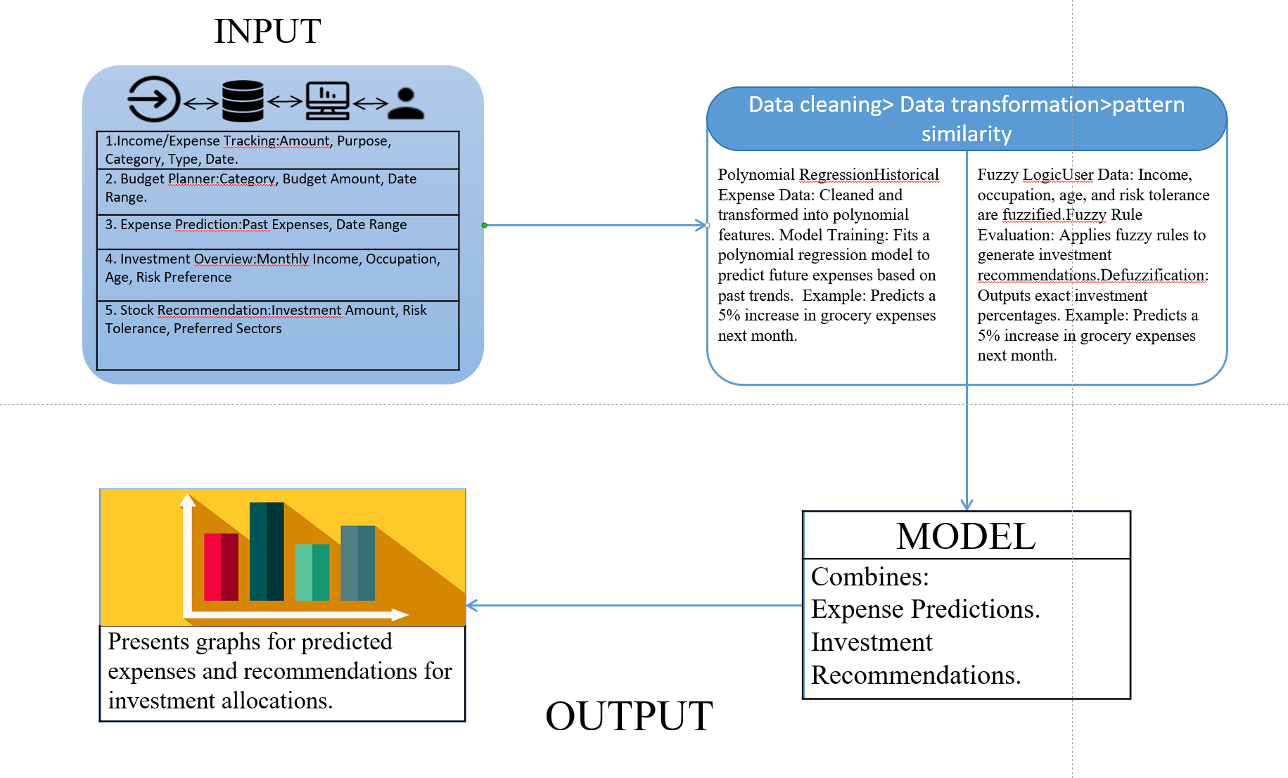
System Design

Slide 11
Technologies and methodologies
Front-End
HTML5
CSS3
JAVASCRIPT ES2024
Back-End
Flask: Python Framework 2.8.0
Database
SQL 8.0
Datasets
expenses dataset
investment_recommender_dataset
Algorithm
Linear Regression (Expense Prediction)
Decision Tree

Slide 12
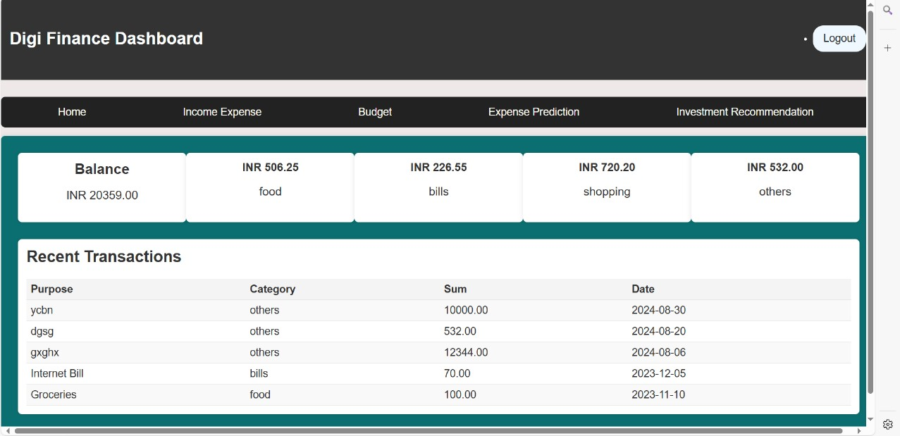
Implementation

Slide 13
Conclusion
Hence, Devlopment and Implementation of 80% of Web based platform providing seamless user experience.
DigiFinance is providing a comprehensive platform for user ,through it’s user-friendly interface.

Slide 14
References
[1] The Future of Personal Finance Management – A Machine Learning-Driven Approach for Predictive Analysis and Efficient Expense Tracking, 4th International Conference for Emerging Technology (INCET) Belgaum, India,2023.
[2] Prediction of Accrual Expenses in Balance Sheet Using Decision Trees and Linear Regression, Zhejiang University,2016
[3] A Trend-aware Investment Target Recommendation System with Heterogeneous Graph , International Joint Conference on Neural Networks,2021

Slide 15
Thank You...!!

